Slide 1
Pseudorandom number generators (PRNG)
PRNG
Random Value
Seed
State

Slide 2
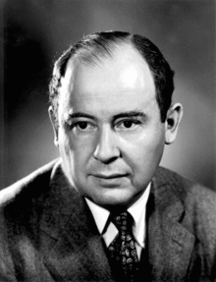
To generate a sequence of n-digit pseudorandom numbers, an n-digit starting value is created and squared, producing a 2n-digit number. If the result has fewer than 2n digits, leading zeroes are added to compensate. The middle n digits of the result would be the next number in the sequence, and returned as the result. This process is then repeated to generate more numbers.
Middle-square method
The method was invented by John von Neumann, and was described at a conference in 1949

Slide 3
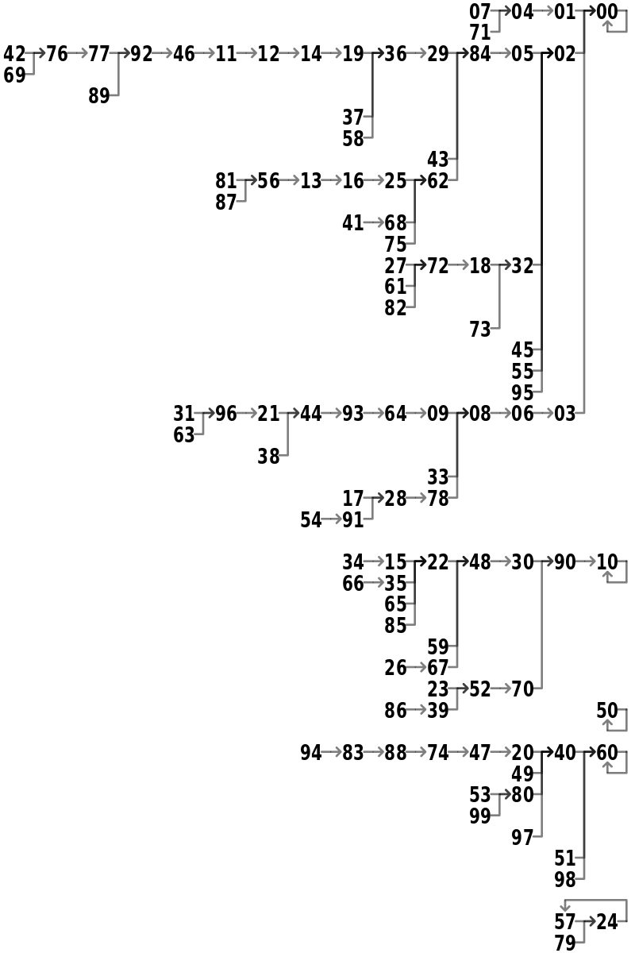

Slide 4
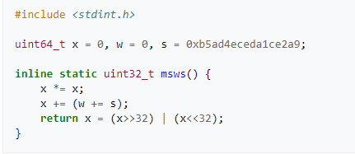
Middle Square Weyl Sequence PRNG

Slide 5
C# Random Class
The current implementation of the Random class is based on a modified version of Donald E. Knuth's subtractive random number generator algorithm. For more information, see D. E. Knuth. The Art of Computer Programming, Volume 2: Seminumerical Algorithms. Addison-Wesley, Reading, MA, third edition, 1997.
To generate a cryptographically secure random number, such as one that's suitable for creating a random password, use the RNGCryptoServiceProvider class or derive a class from System.Security.Cryptography.RandomNumberGenerator.

